Slide 1

MY INNER

Slide 2
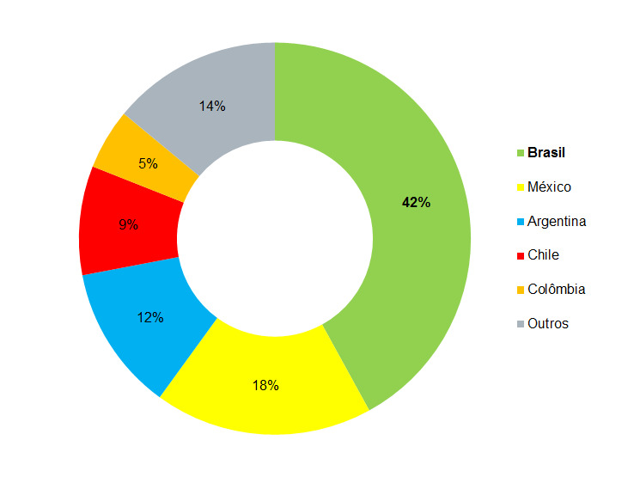

Slide 3
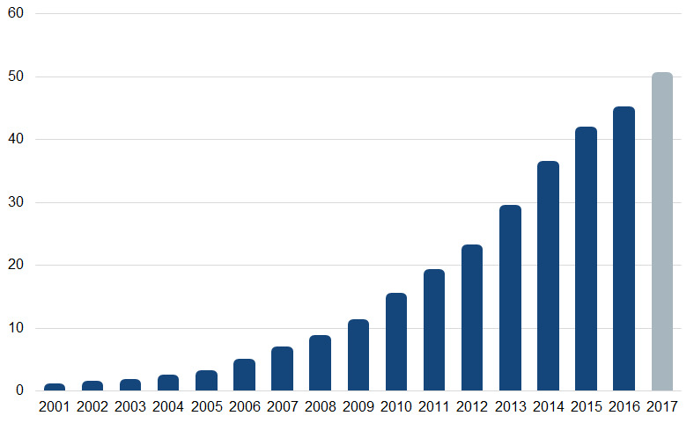

Slide 4


Slide 5











